Slide 1
Complexity: deployment

Slide 2
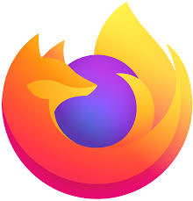

Slide 3
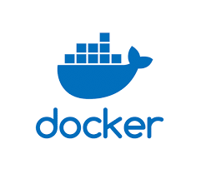

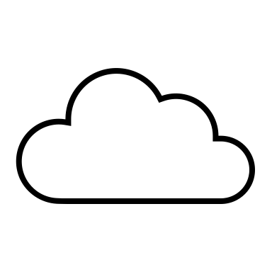
Source code
Image
Image
Container
$docker build .
$ docker run
$ docker push
$ docker pull
push
installation
compilation
execution
Source code
Application
Application
installed
Running Application

Slide 4
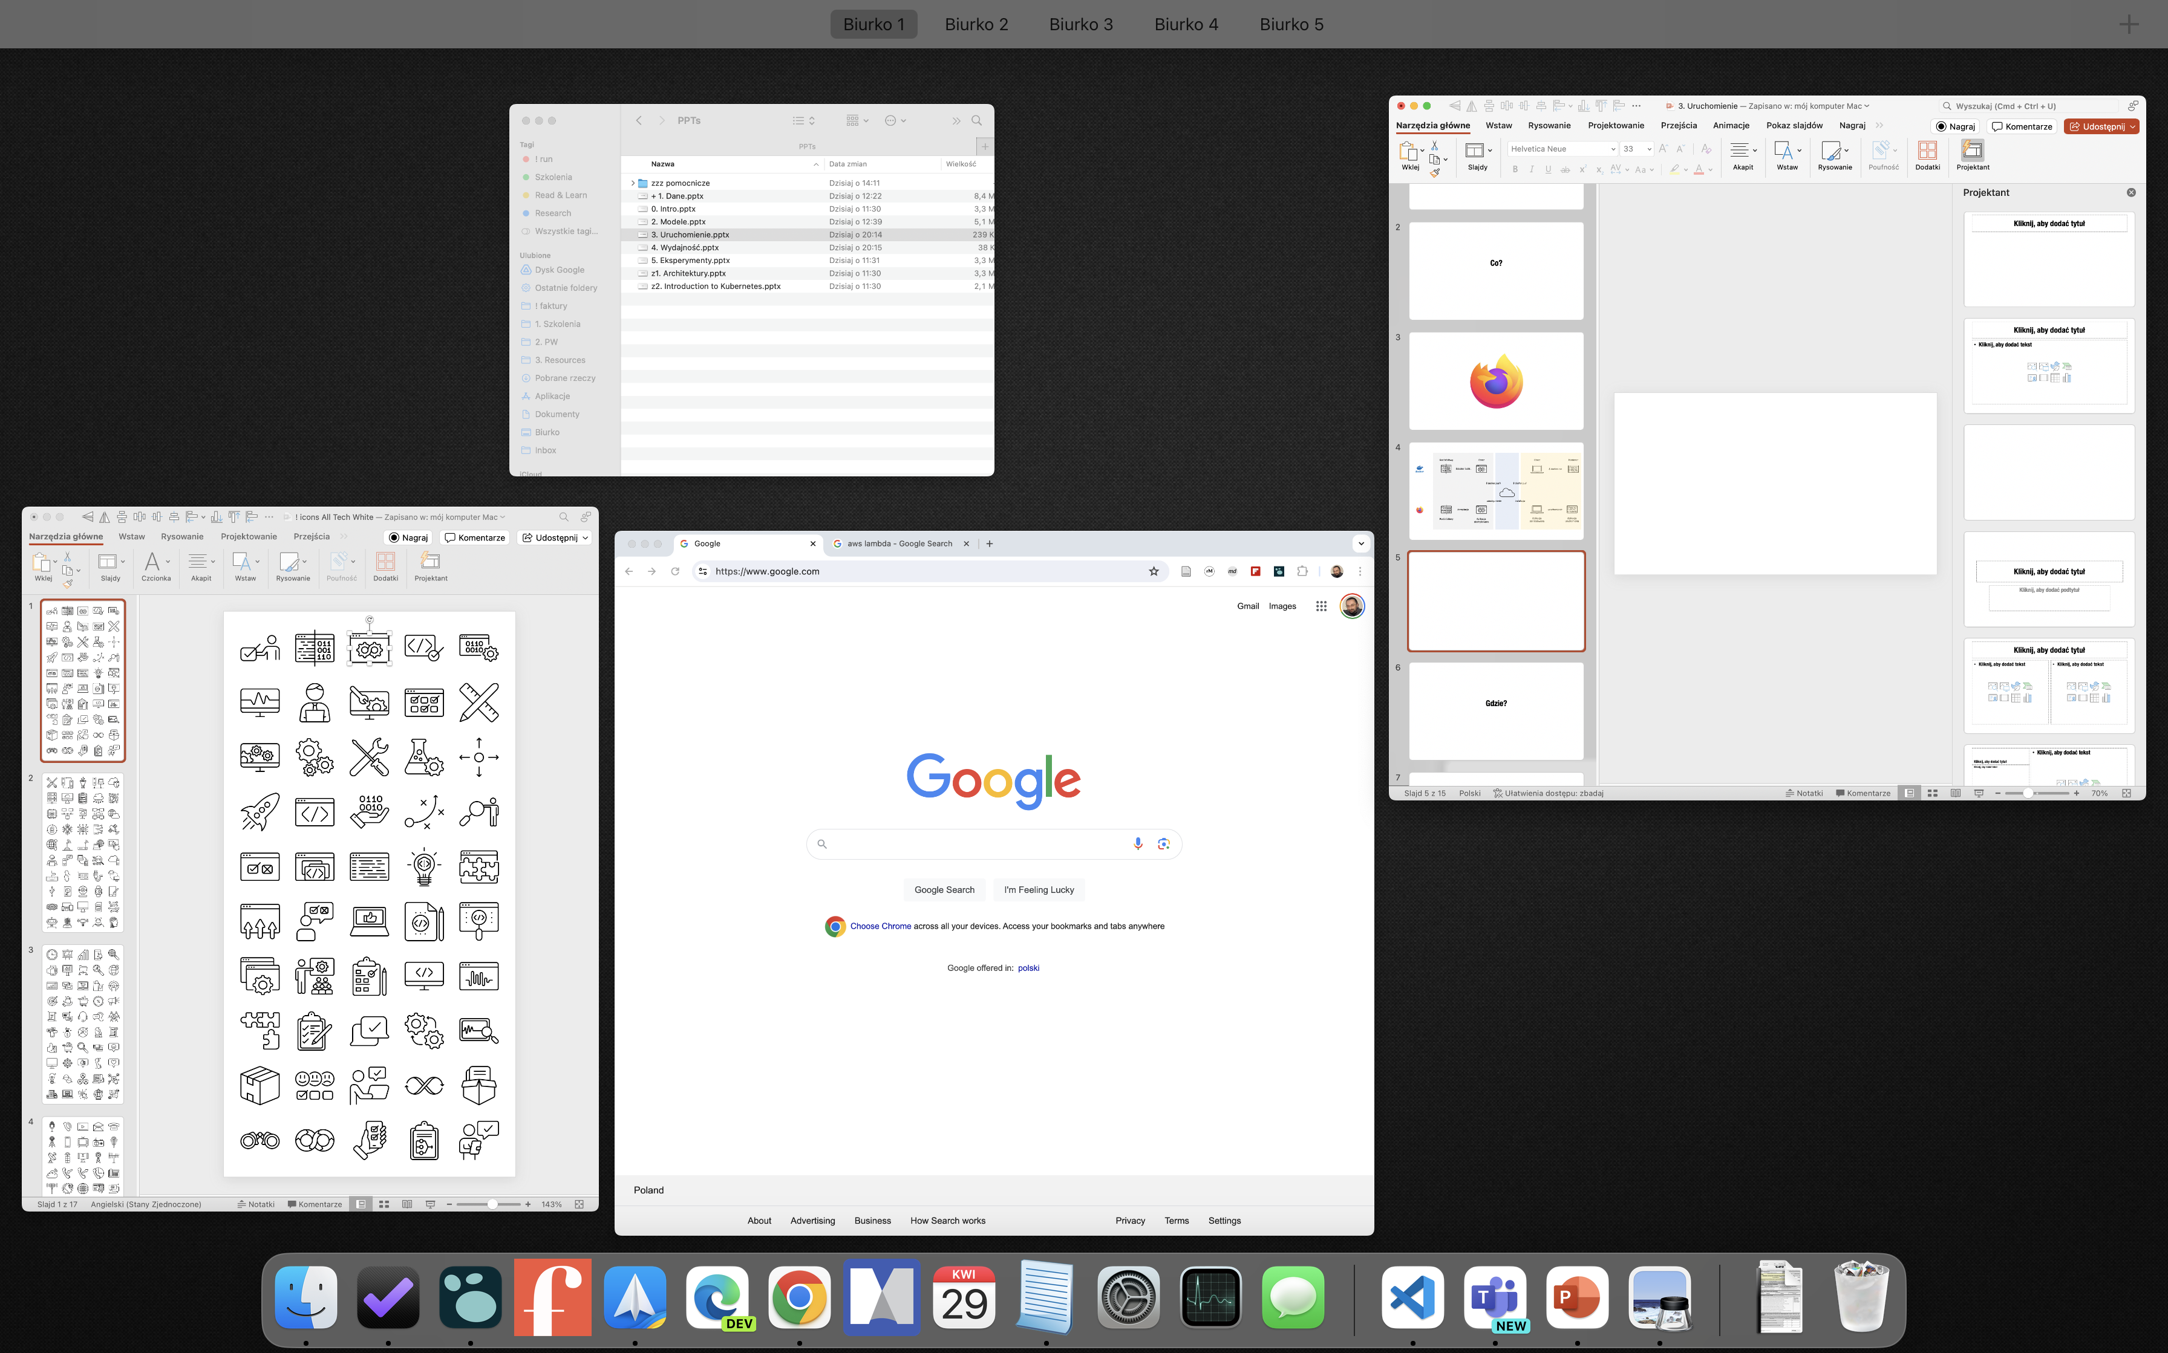

Slide 5
Google: ok. 3 tys kontenerów/sekundę…

Slide 6
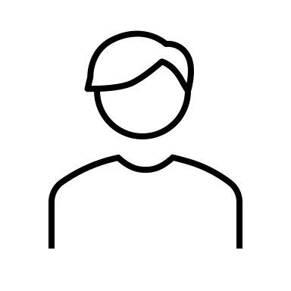
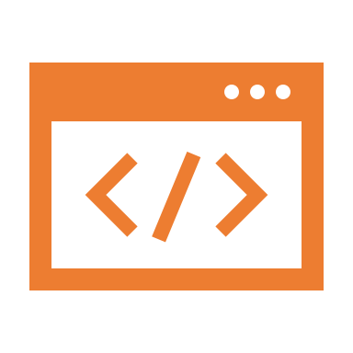
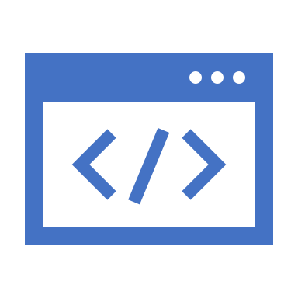
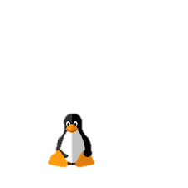
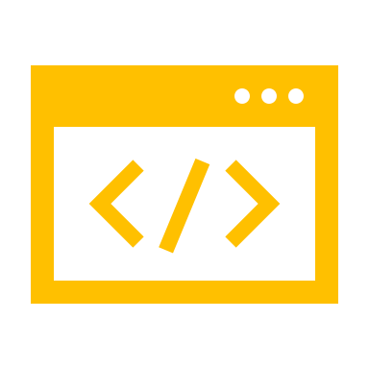
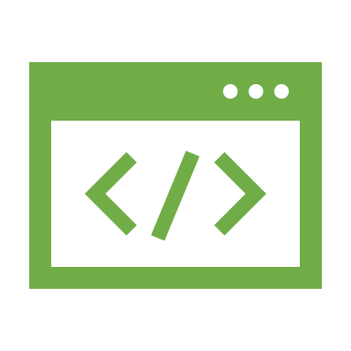
Operating system
apps
frees us from thinking about infrastructure
processor
interfaces
peripherals
network
memory

Slide 7
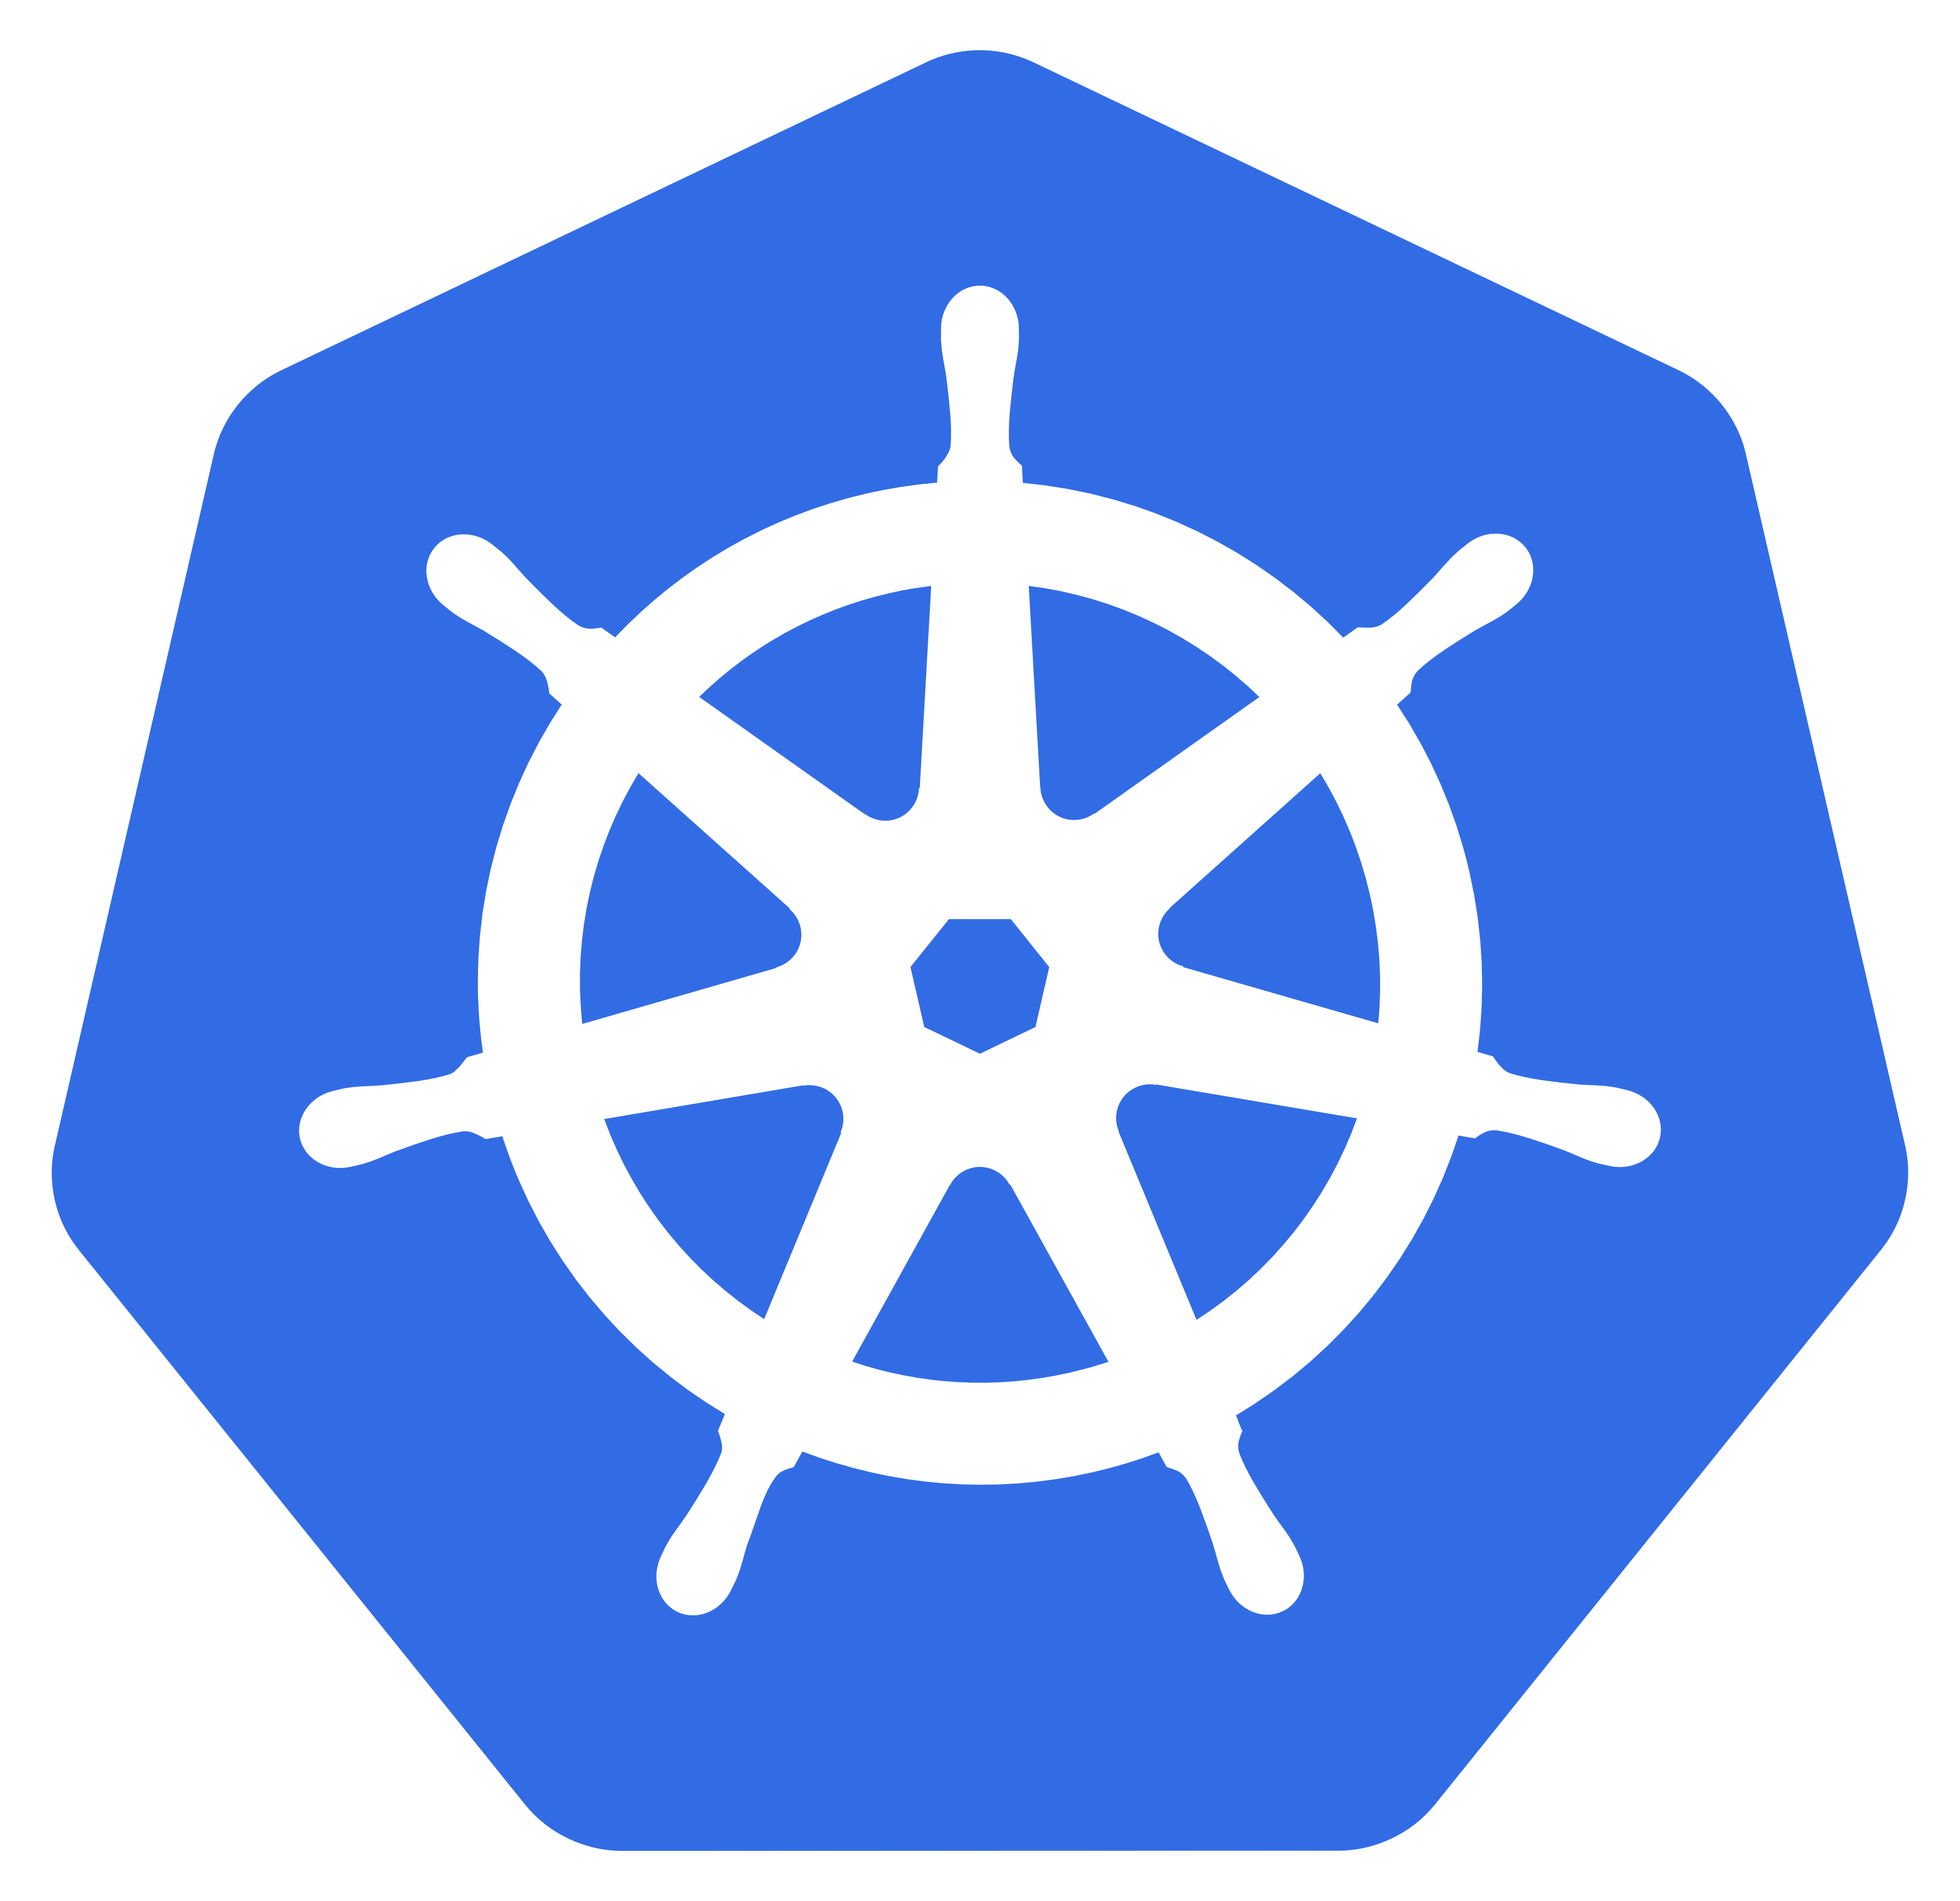
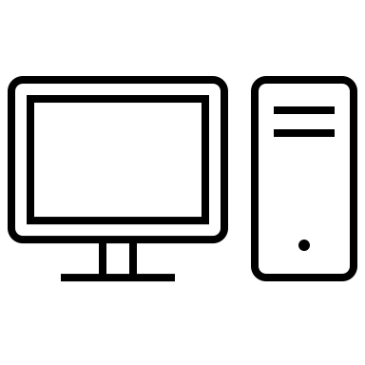
Kubernetes (k8s)
apps
frees us from thinking about infrastructure
serwer
sewer
serwer
serwer
serwer

Slide 10
API

Slide 11
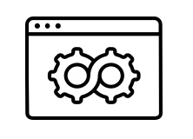
API

Slide 12
API

Slide 13
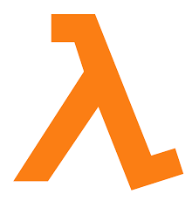
API

Slide 14
API

Slide 15
API

Slide 16
What? | Where? | How?
Application | Local | Directly
Docker | Server | REST API
 | Serverless | Web interface
 |  | Mobile app

